Slide 1

Scheduling Pipelined Circuits Gordan Konevski

Slide 2
Delineation

Slide 3
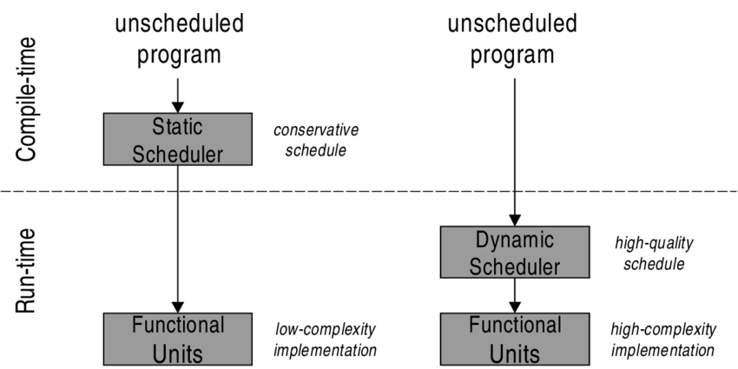
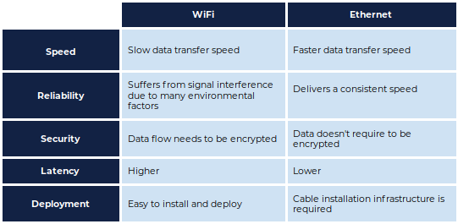

Slide 4

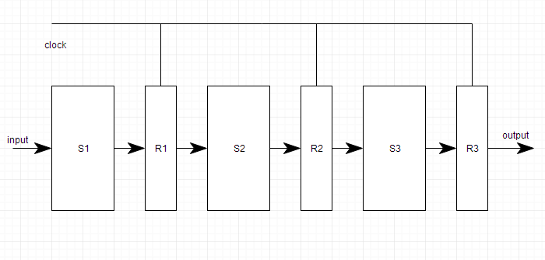

Slide 5
Examples

Slide 6
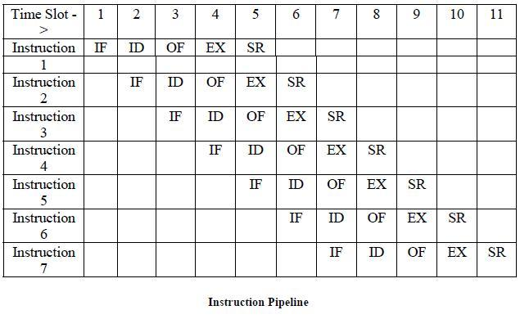
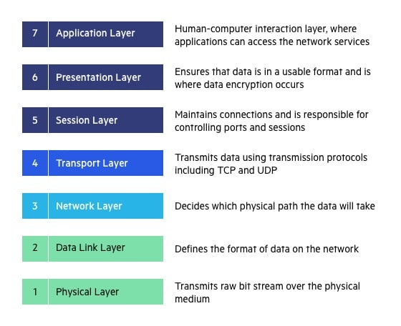
7 Layer Model

Slide 7
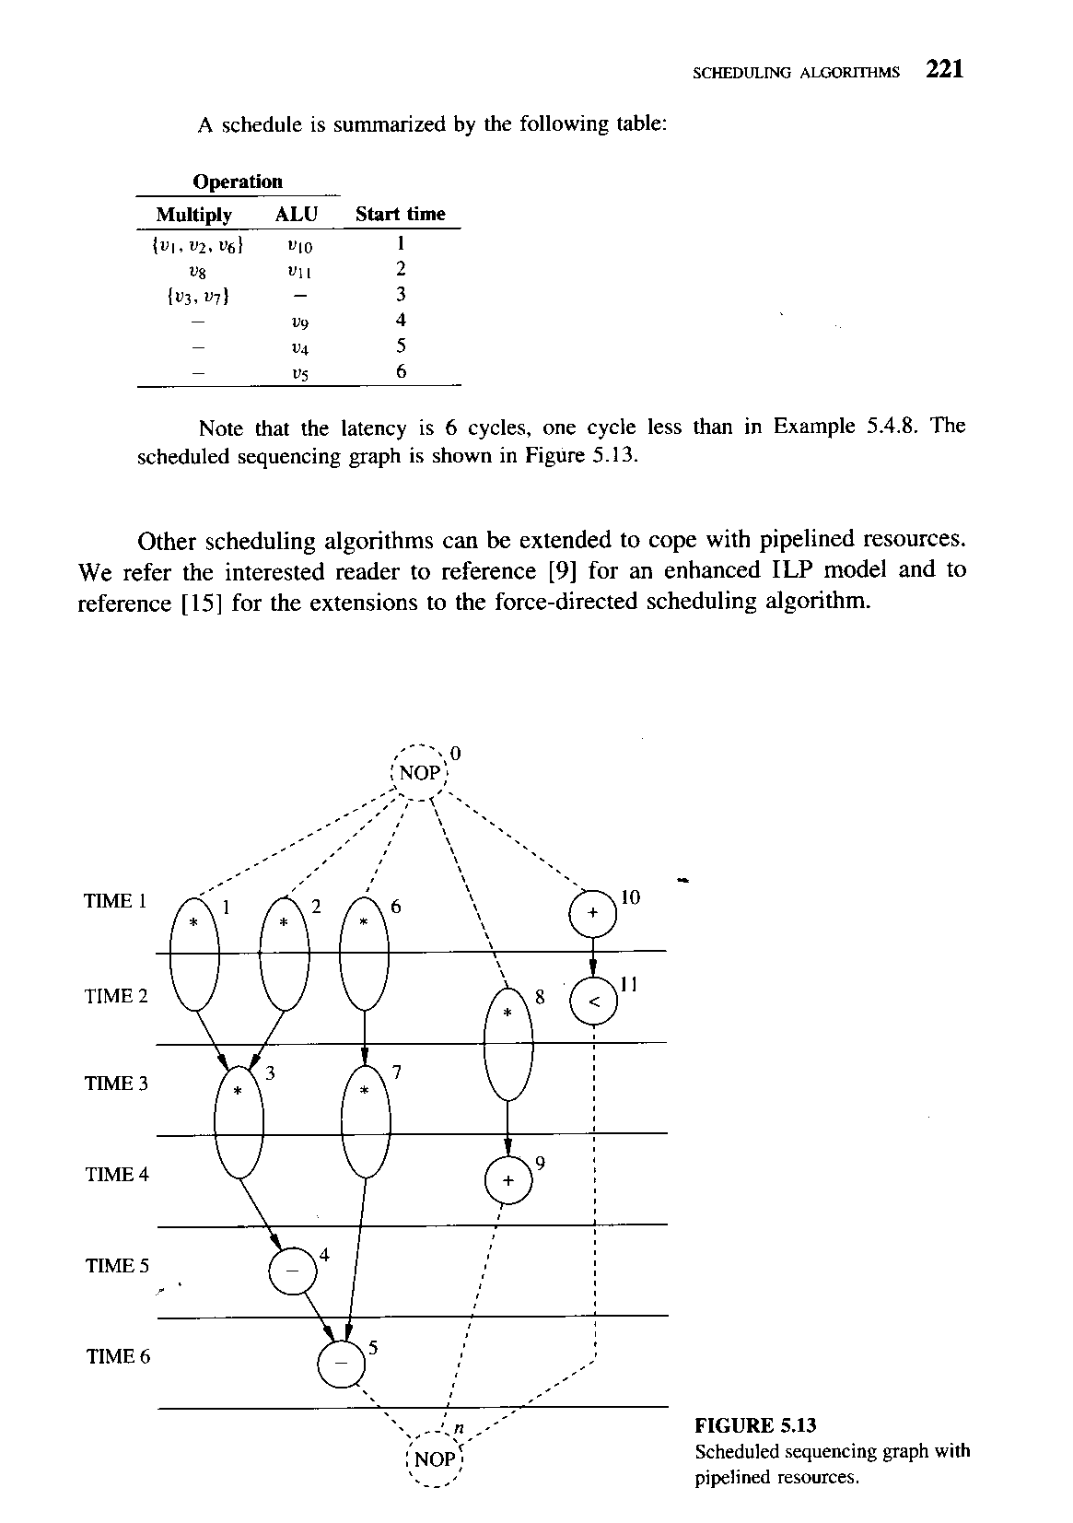
Scheduling with Pipelined Resources

Slide 8



Slide 9
The End

Slide 10
Used Material
http://cssimplified.com/wp-content/uploads/2014/11/Instruction Pipeline.jpg
https://www.researchgate.net/figure/Dependency-graph-b-of-an-instruction-block-a fig7 299520102
http://cssimplified.com/computer-organisation-and-assembly-language-programming/explain-the-working-of-the-instruction-pipelining-with-the-help-of-a-diagram-5m-dec2005
https://www.researchgate.net/figure/The-effect-of-bottleneck-stages-on-the-performance-of-a-pipeline-Here-we-have-a_fig3_222539867
https://link.springer.com/content/pdf/10.1007%2F3-540-55984-1 19.pdf
Giovanni De Micheli - Synthesis and Optimization of Digital Circuits

